Slide 1
Generating Answers: Input Text ==> Chunking ==> Embedding ==> Search Index ==> Query ==> Search ==> Question ==> Answer
Savitha Shree M (19981)

Slide 2
TABLE OF CONTENTS
INTRODUCTION
DESIGN
IMPLEMENTATION
SAMPLE OUTPUT
CONCLUSION

Slide 3
INTRODUCTION
The project involves breaking down the input text into manageable chunks, converting them into embeddings, indexing them for efficient retrieval, querying the indexed data, conducting a search based on the query, formulating a question, and ultimately generating an appropriate answer.
By implementing this workflow, the system aims to effectively address inquiries or provide relevant information based on the input text, thereby enhancing its utility and effectiveness in various applications such as information retrieval, customer support, or knowledge management.

Slide 4
DESIGN
It is built in Python Programming language.
The four major steps involved are:
Preprocessing Input text
Embedding
Searching
Generating answers

Slide 5
INSTALLATION
Create python virtual environment
sudo apt install python3.10 -venv
Install the required packages
python -m venv env
source env/bin/activate
pip install annoy

Slide 6
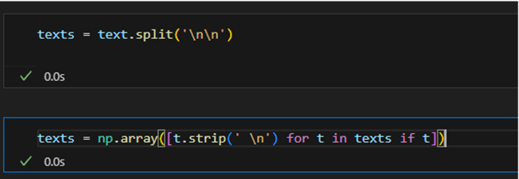
IMPLEMENTATION
PREPROCESSING- The given text is split into list of paragraphs, then newline and empty spaces are removed from it.

Slide 7
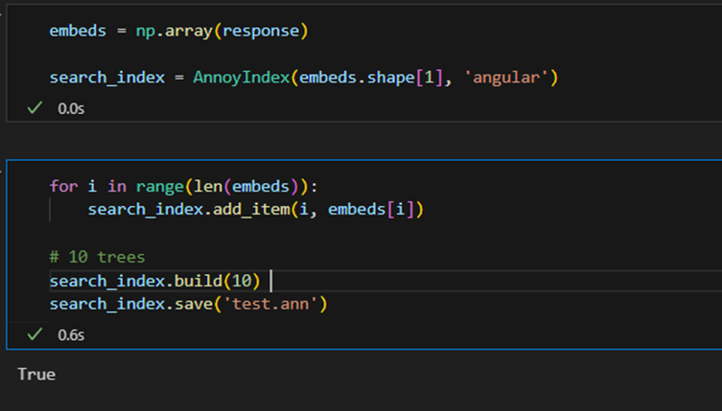
IMPLEMENTATION
EMBEDDING - Get the embeddings and build a search index from embeddings. Add all vectors to the search index. Search index is used to organize and retrieve embeddings effectively.

Slide 8
IMPLEMENTATION
SEARCHING:

Slide 9
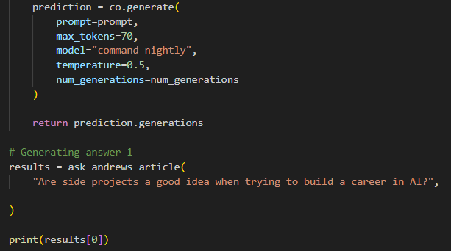
IMPLEMENTATION
GENERATING ANSWERS:

Slide 10
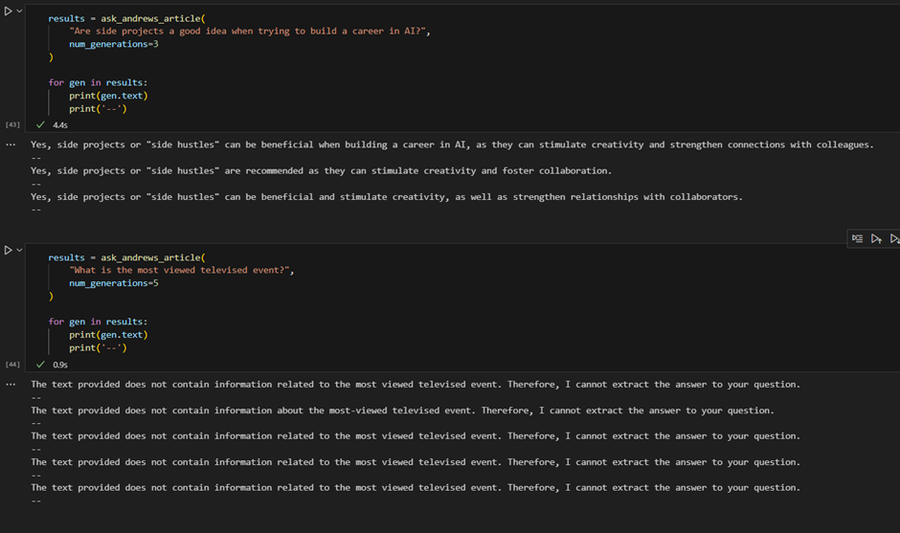
SAMPLE OUTPUT

Slide 11
CONCLUSION
GITHUB LINK:
https://github.com/savithashreem07/Fine-Tuning/tree/feature/generating-answers/Generating%20Answers
REFERENCES:
https://learn.deeplearning.ai/courses/large-language-models-semantic-search/lesson/6/generating-answers
https://docs.cohere.com/reference/embed

